Slide 1


City of Arcadia
Draft Maps Review Hearing

Slide 2
2021/2022 Arcadia Redistricting
The 2021/2022 redistricting process
  Project timelines
  Key deadlines
  Review of draft maps
  Project website – ArcadiaCA.gov/redistricting

Slide 3
Arcadia Elections
Mayor & Council Members hold 4 -year terms
  Districts 1 & 4 terms end November 2024*
  Districts 2, 3, 5 terms end November 2022*
  *City changed election dates from April to November in order to comply with California’s SB 415

Slide 4
Redistricting Process
Step | Description
Initial Pre-Draft Hearing(s) August 17 and November 10 | Held prior to release of draft maps. Education and to solicit input on the communities in the City. Identify “neighborhoods,” “communities of interest,” and “secondary areas.”
Initial deadline for draft maps | Deadline for the public to submit draft maps for inclusion in the next hearing packet and presentation
Release draft maps | Draft maps posted to project website
Two hearings on draft maps February 7 and March 15 | Two meetings to discuss and revise the draft maps and to discuss the election sequence.
Map adoption | Map adopted via ordinance. Final map must be posted at least 7 days prior to adoption.

Slide 5
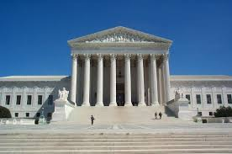
Redistricting Rules and Goals
1. Federal Laws
2. California Criteria for
Cities
3. Other Traditional Redistricting Principles
Equal Population
Federal Voting Rights Act
No Racial Gerrymandering
Geographically contiguous
Undivided neighborhoods and “communities of interest”
(Socio-economic geographic areas that should be kept together)
Easily identifiable boundaries
Compact
(Do not bypass one group of people to get to a more distant group of people)
Prohibited:
“Shall not favor or discriminate against a political party.”
Minimize voters shifted to different election years
Respect voters’ choices / continuity in office
Future population growth
Preserving the core of existing districts

Slide 6
Arcadia Demographic Overview
City of Arcadia - 2020 Census Data Total Population Statistics
District | CA Adjusted Pop. | Deviation | % Deviation | % Hispanic Origin | % NH White | % NH Black | % NH Asian
1 | 11,330 | -26 | -0.23% | 13.56% | 18.60% | 1.68% | 64.95%
2 | 10,265 | -1091 | -9.61% | 14.71% | 25.20% | 1.96% | 56.43%
3 | 12,148 | 792 | 6.97% | 17.05% | 15.06% | 2.86% | 63.26%
4 | 11,890 | 534 | 4.70% | 8.27% | 14.10% | 1.49% | 74.52%
5 | 11,148 | -208 | -1.83% | 11.98% | 16.04% | 1.15% | 69.09%
 |  | Total Deviation | 16.58%
City of Arcadia CVAP Data
District | Latino CVAP | White CVAP | Black CVAP | Asian CVAP
1 | 8.24% | 29.17% | 2.54% | 59.29%
2 | 13.49% | 38.26% | 2.38% | 45.37%
3 | 16.69% | 26.09% | 5.04% | 51.95%
4 | 6.60% | 22.06% | 1.66% | 68.28%
5 | 9.11% | 25.15% | 0.48% | 64.36%
Tables show official 2020 demographic data
Each of the 5 districts must contain about 11,356 people.

Slide 7
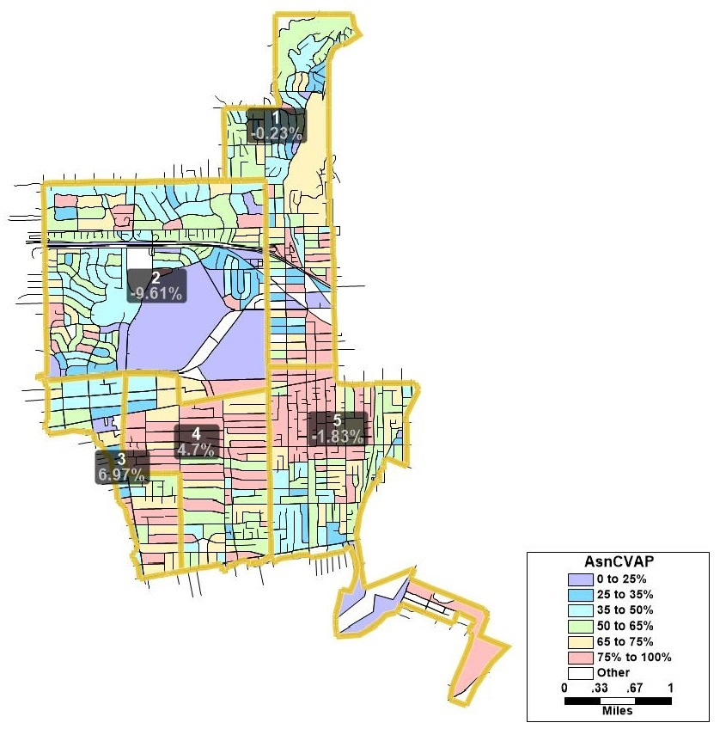
Asian-American CVAP

Slide 8
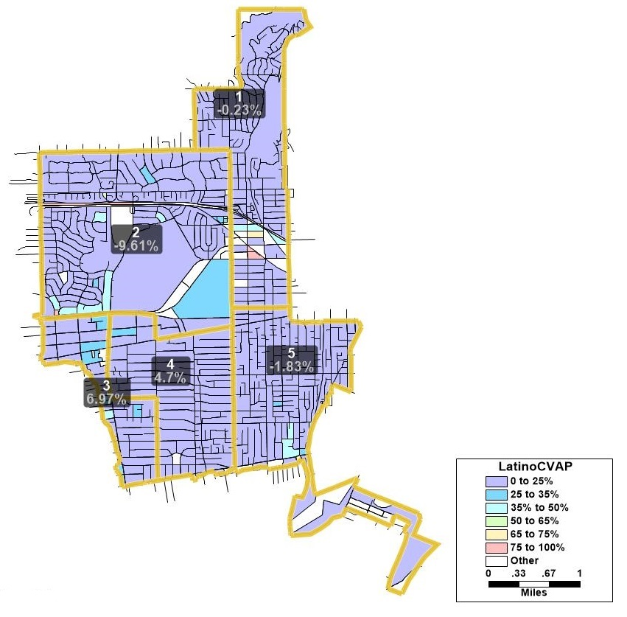
Latino CVAP

Slide 9
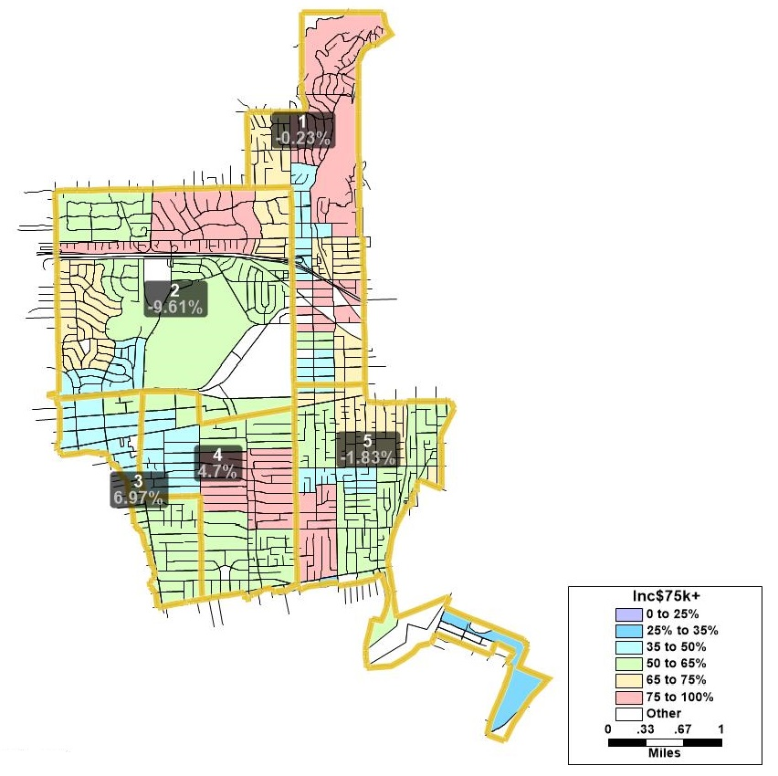
Income

Slide 10
Possible Neighborhoods / Communities
Neighborhoods
Commercial Areas
HOAs
Other designated areas

Slide 11
Timeline & Next Steps
Date(s) | Description | Comments
August 17, 2021 | 1st Public Hearing
October 2021 | Mapping software released to the public. US Census data released mid-August. California released the prisoner-adjusted redistricting data on September 27
November 10, 2021 | 2nd hearing – Community Workshop
January 15, 2022 | Deadline to receive draft maps
February 7, 2022 | 3rd hearing
Early-March, TBD | Publish revised map(s) | 7 Days prior to adoption
March 15, 2022 | Proposed 4th hearing. | Final Hearing and Council adopt District map. Must be completed no later than April 17, 2021
April 17, 2022 (E-205) | City deadline to adopt and submit map to Registrar

Slide 12
For the Remainder of This Evening’s Hearing
Any questions about the presentation?
Review of draft maps
Provide us Feedback on:
  Draft maps
    Are there maps that you would like to see changed or edited?
    Further discussion at the March 15th hearing

